Slide 1
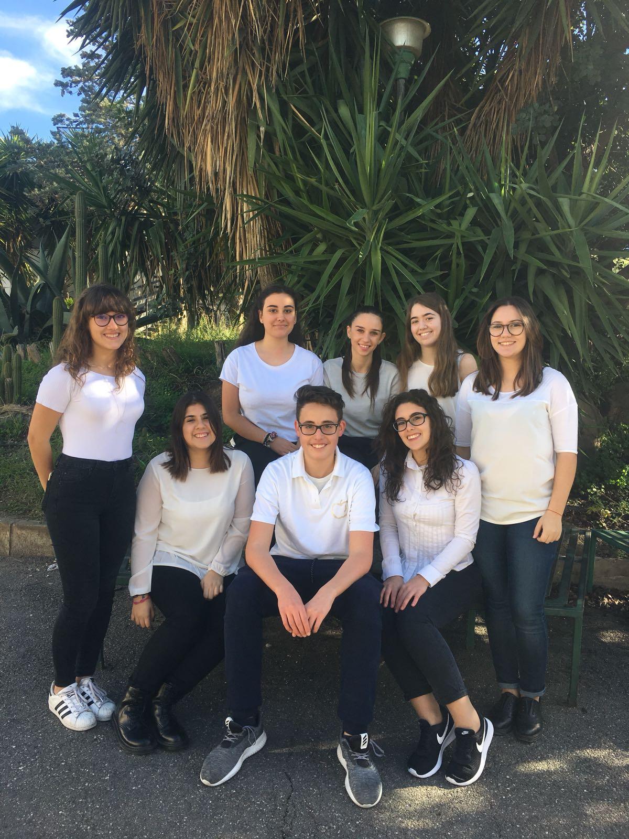
CATALOG:
Crafts and food

Slide 2
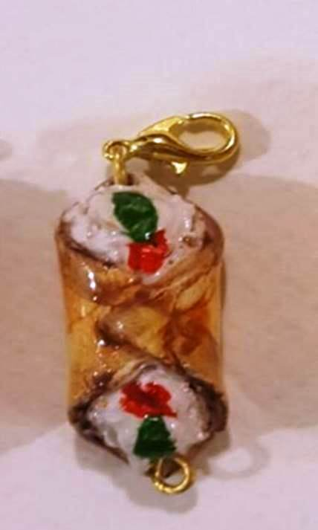
Desciption: pendants in ceramics.
Price: 4,49€
Weight: 5g approximately

Slide 3
Description: square in igneous rocks with traditional sicilian scenes.
Price: 5,00€

Slide 4
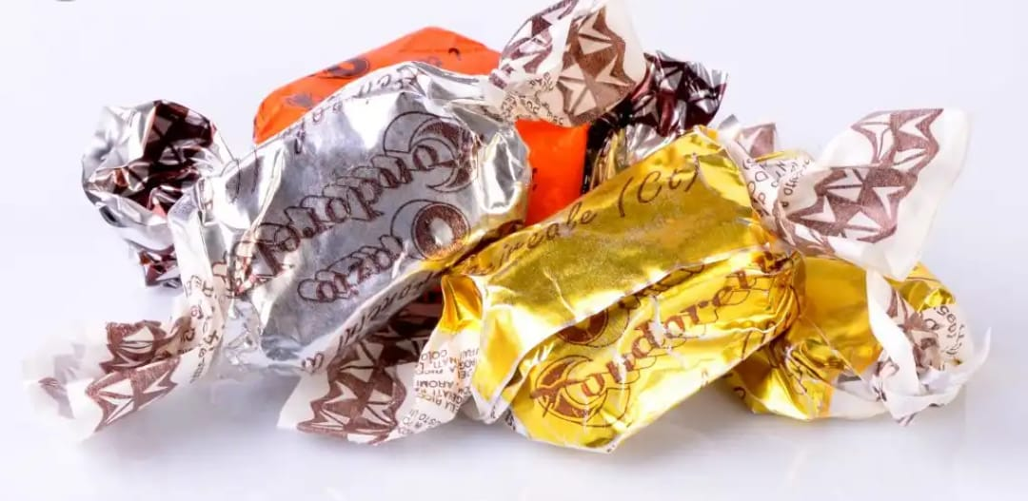
Description: Torroncini with almonds and pistachios covered by chocolate. Price: 3,00€ Weight: 100g

Slide 5
Description: dough of almond (sweet biscuits to the almond) Price:2,50€ Weight: 100g

Slide 6
Description: sweet cream of pistachios.
Price: 4,50€
Weight: 200g

Slide 7
Description: Marzipan is a dessert composed of almond past combined with sugar and white eggs. Price: 5€ for 150g or 10€ for 350 g.

Slide 8
Description: «Sanguinella» is a non-alcoholic drink composed by frizzy water and red oranges typical of Sicily. Price:2€ for bottle (minimum order quantity six pieces, purchasable in multiple of six).

Slide 9
Description: «Verdello» is a non-alcoholic drink composed by frizzy water and yellow lemon typical of Sicily. Price:2€ for bottle (minimum order quantity six pieces, purchasable in multiple of six).

Slide 10
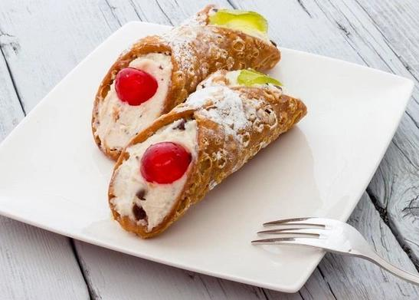
Description: cannoli are a typical sicilian dessert. Every wafer/cannolo must be filled in with chocolate cream, white cream or sweeted ricotta cheese ( see the picture below).
Price: 4,50€ for 250g

