Slide 1
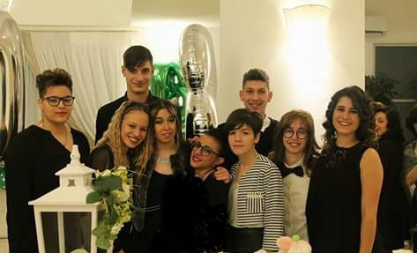
products PUGLIESI

Slide 2
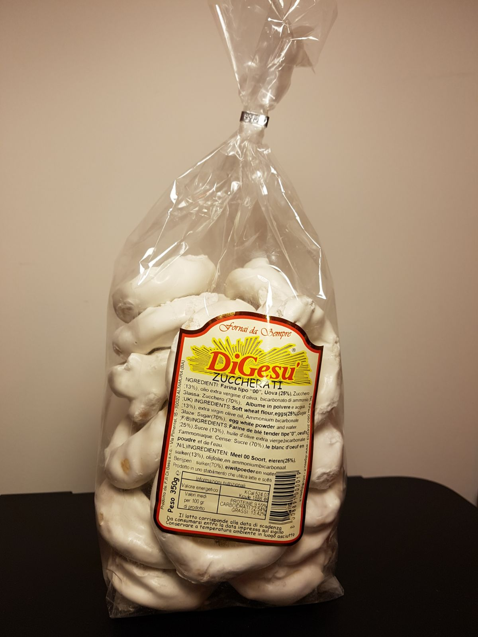
Taralli with sugar digesu’
00 flour
sugar
extra virgin olive oil
yeast
Unit price
Pack of 500= €3,50

Slide 3
Extra virgin olive oil FRANTOIO DELLORUSSO BITONTO
Olive
Unit price
1 liter = €5,00

Slide 4
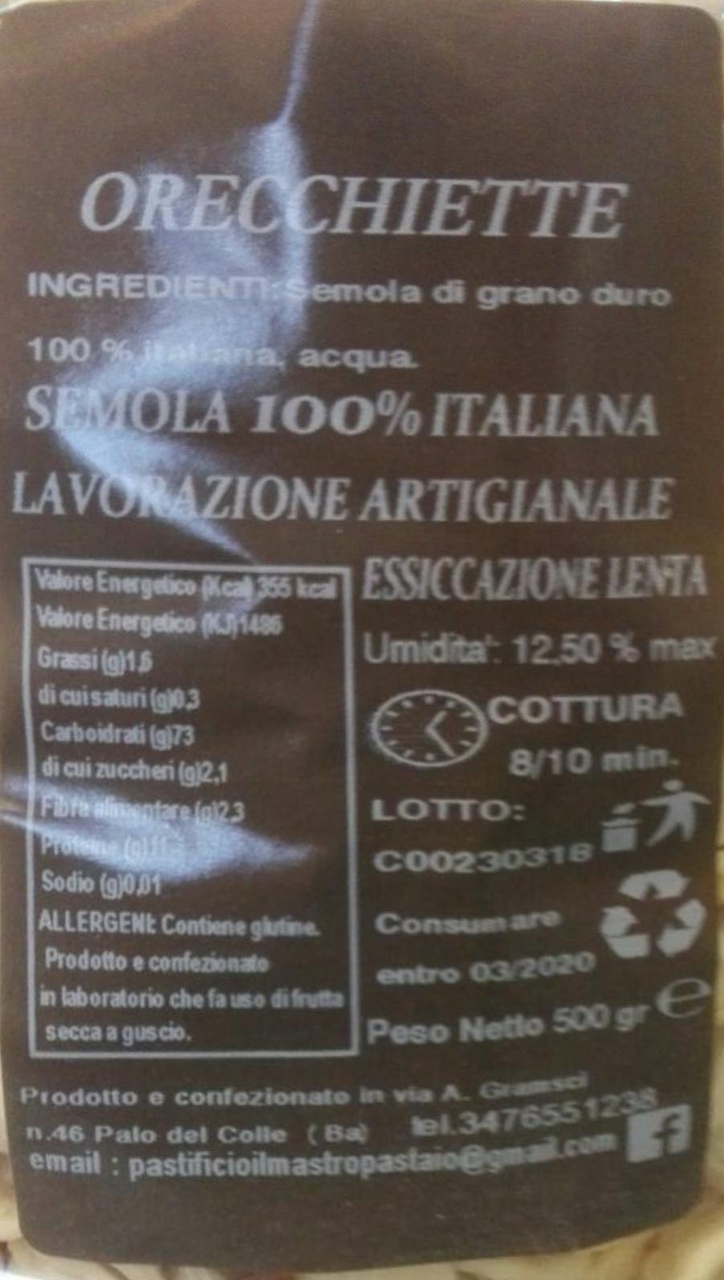
orecchiette baresi il mastro pastaio
durum wheat re-milled semolina
warm water
salt
Unit price
500 gr at € 3.50

Slide 5
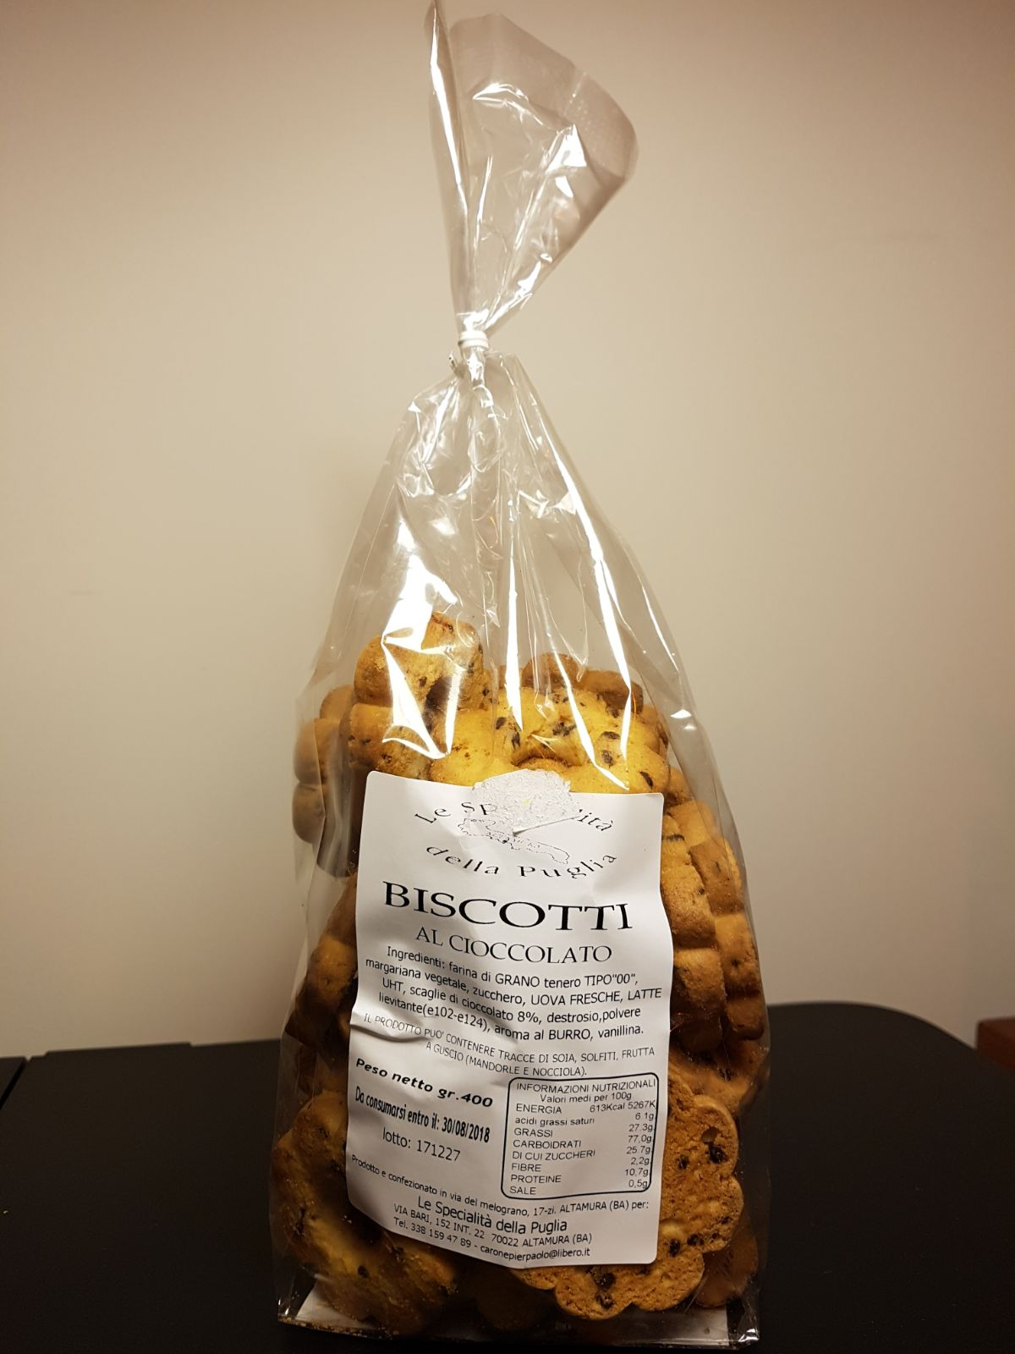
Chocolate cookies le specialita’ della puglia
soft wheat flour TYPE 00
vegetable margarine,
sugar,
FRESH EGGS
, MILK UHT
chocolate chips
leavening
vanillin
Unit price
400 gr=€3.50

Slide 6
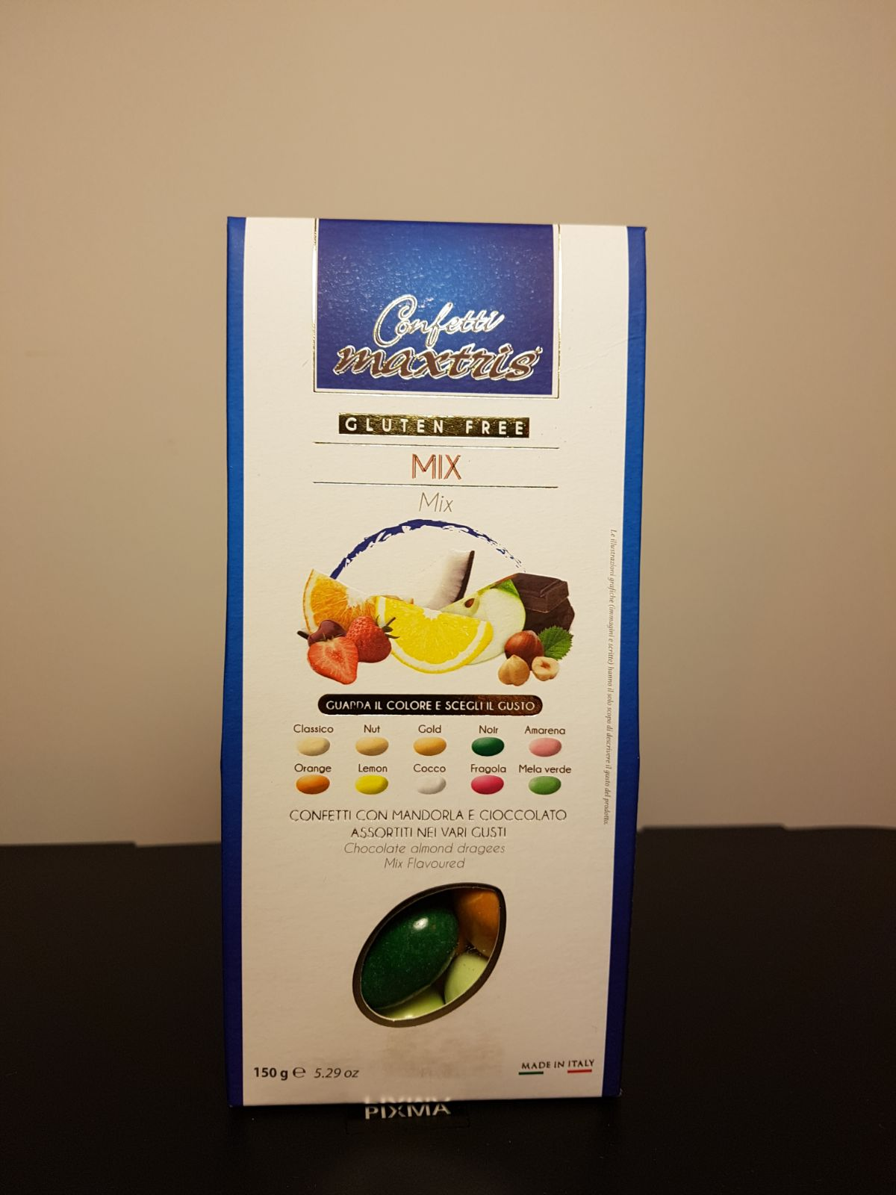
CONFETTI WITH FRUIT
MAXTRIS
sugar,
rice and corn starch,
dark chocolate of fruit
cocoa
Unit price
150 g = € 4.00

Slide 7
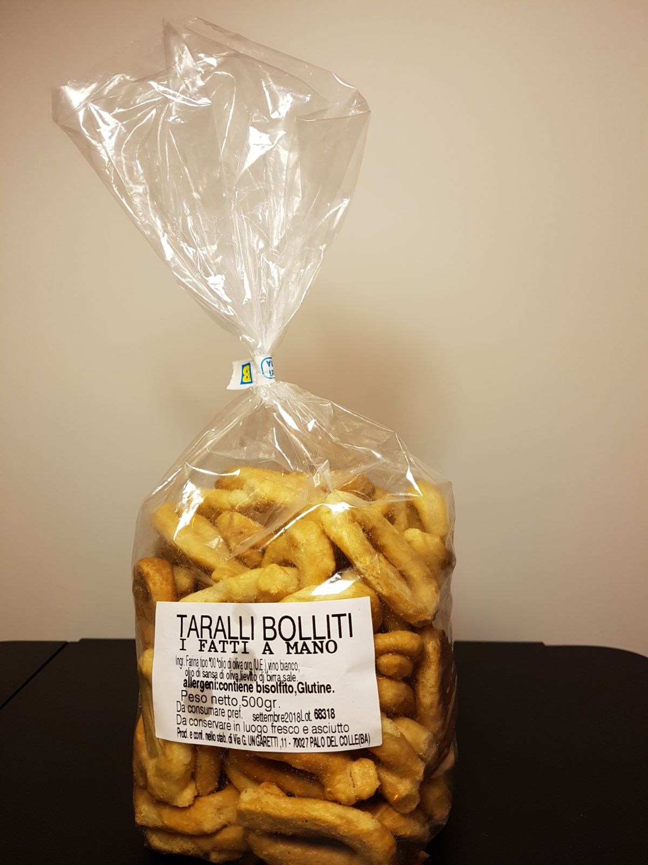
Apulian wood-fired taralli
I FATTI A MANO
00 flour
white Pugliese
Apulian olive oil
Salt enough
Unit price
Pack of 350 gr =€ 3.50

Slide 8
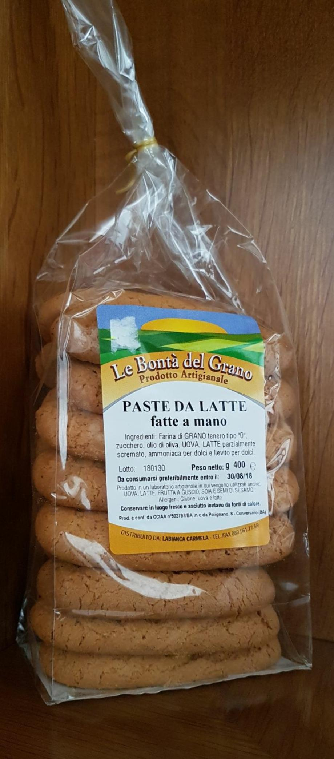
MILK BISCUITS
LA BONTA’ DEL GRANO
00 flour
caster sugar
extra virgin olive oil
eggs
lemon
ammonia in place of a sachet
Of baking powder
milk
Unit price
400 g = €3.00

Slide 9
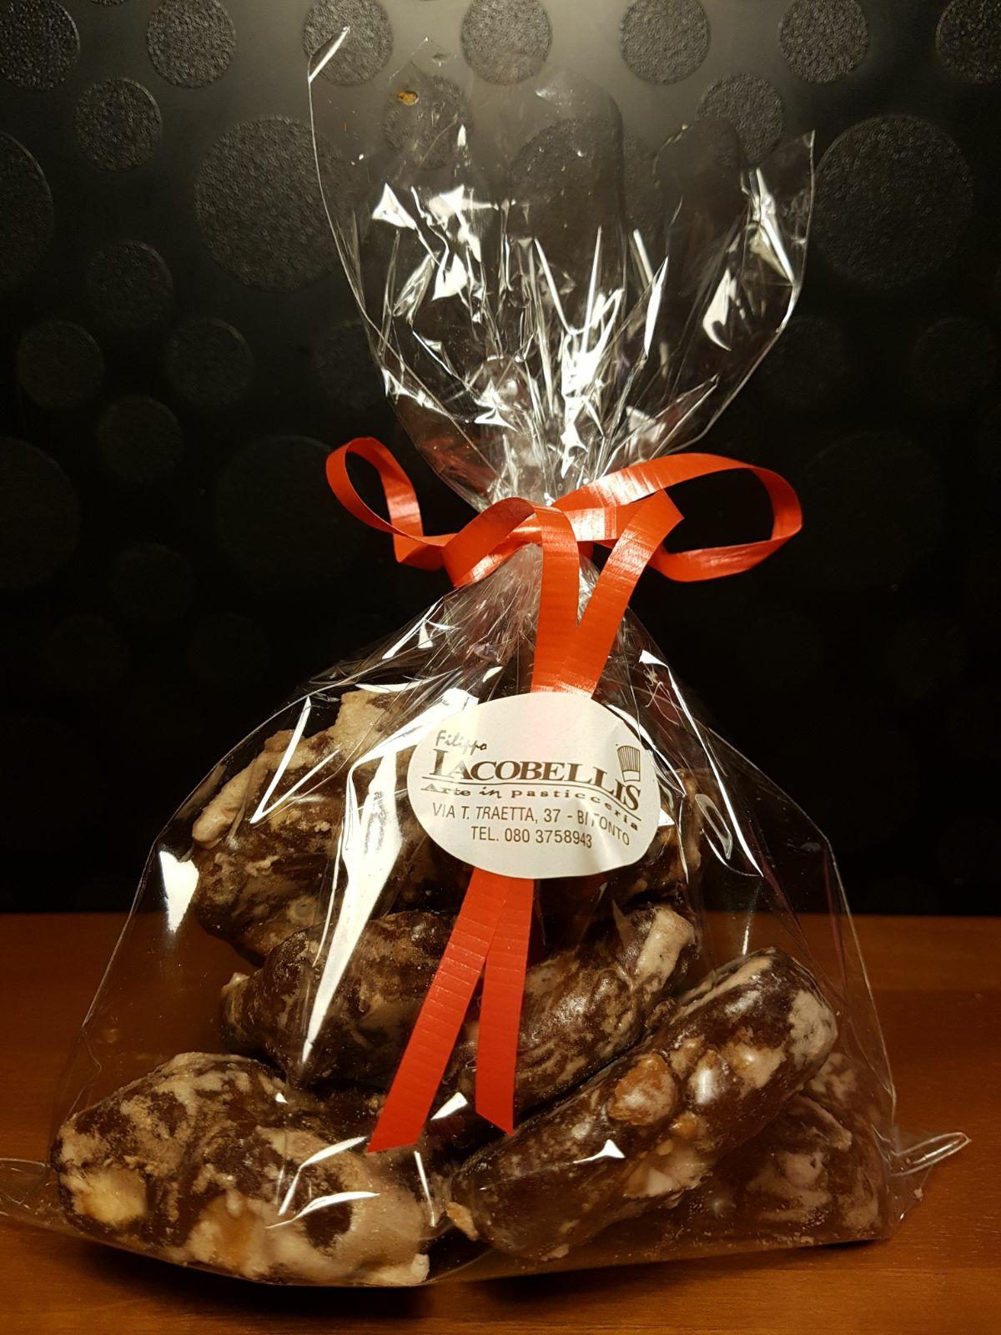
Mostaccioli with almonds
JACOBELLIS
flour 00
sugar
honey
orange
bitter cocoa
sachet of yeast
tablespoon spices cinnamon, nutmeg, cloves
toasted almonds or walnuts, or hazelnuts
dark chocolate
lukewarm water
Unit price
150 g = €4,00

Slide 10
To buy our products, you can send your order to:
fabiocoletto2912@gmail.com

Slide 11
Our products will be sent by courier service
Payment with mastercard or postepay
0,50 € of shipping costs will be added every €3,00 purchase
If you send an order above 25 € you are entitled to free shipping

