Slide 1
DARK LIGHTERS
Catalogo

Slide 2
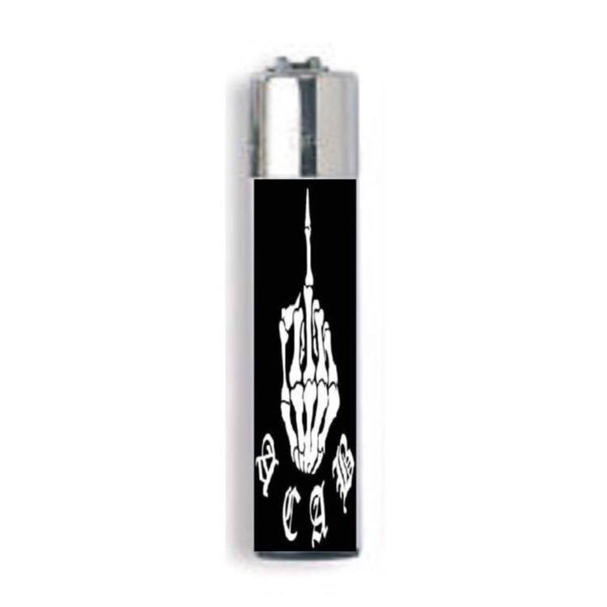
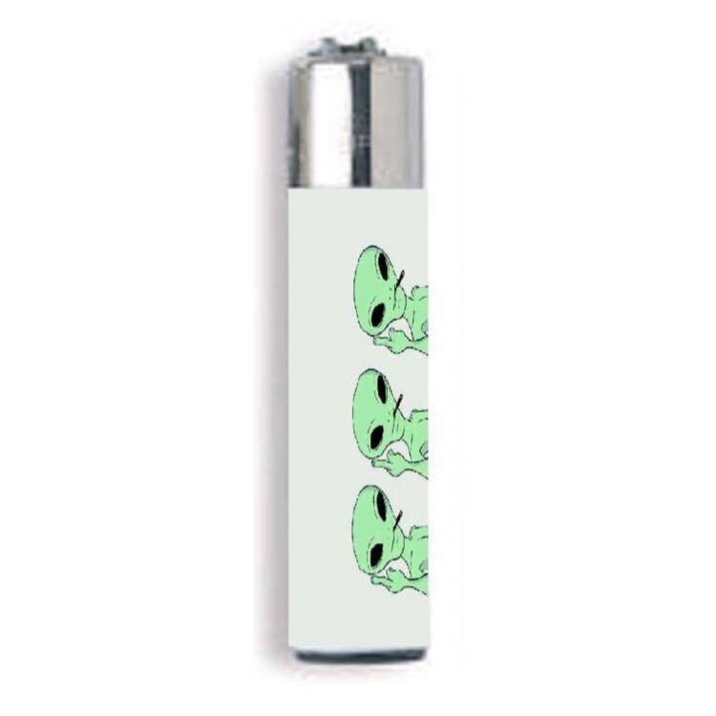
ACAB’S CLIPPER Simple and elegant, with a direct and precise meaning. Only for self confident people.
ALIENS
Do you believe in aliens? This is the lighter for you.

Slide 3
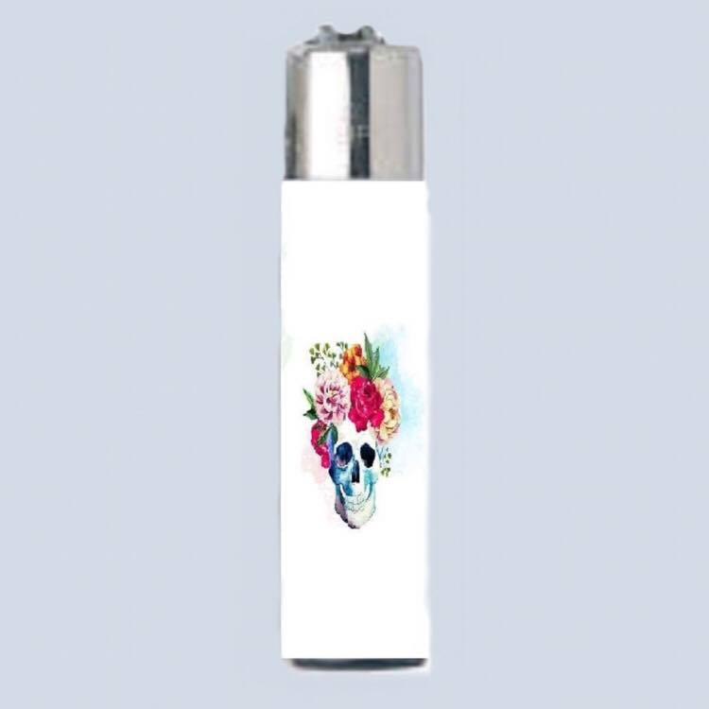
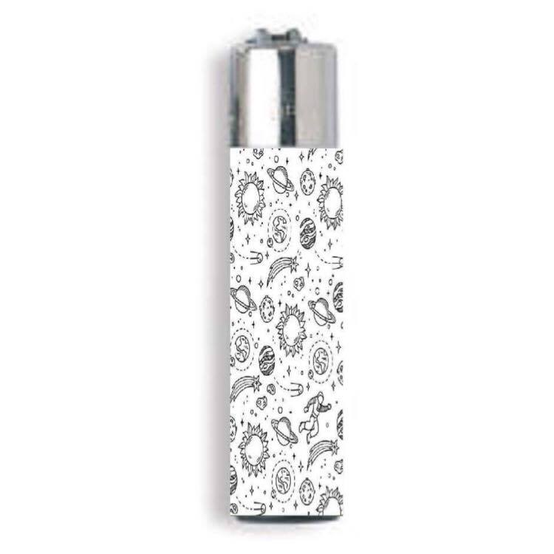
FLORAL SKULL
Do you like two completely different things like flowers and skulls? A floral skull is what you need!
GALAXY
For galactic person.

Slide 4
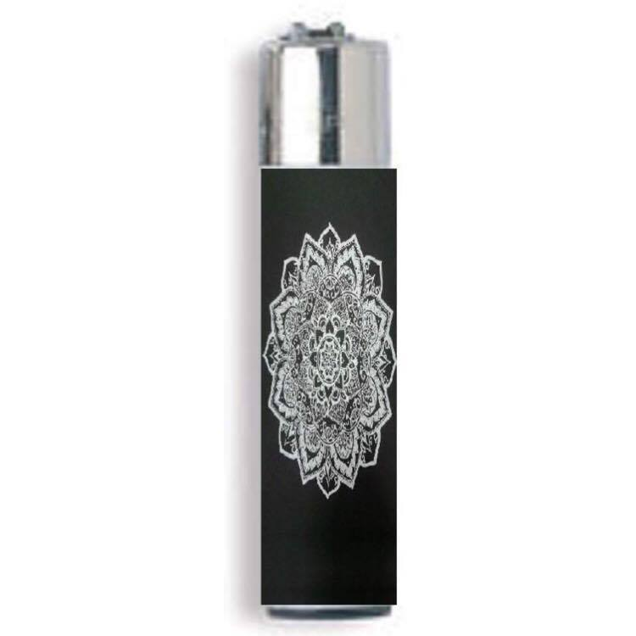
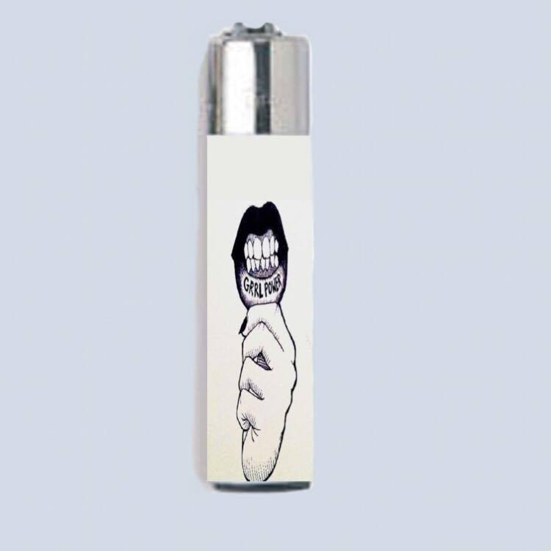
MANDALA’S CLIPPER
A jam of cultures: east and west live together on this lighters.
GIRL POWER
Against gender supremasy; power to women!

Slide 5
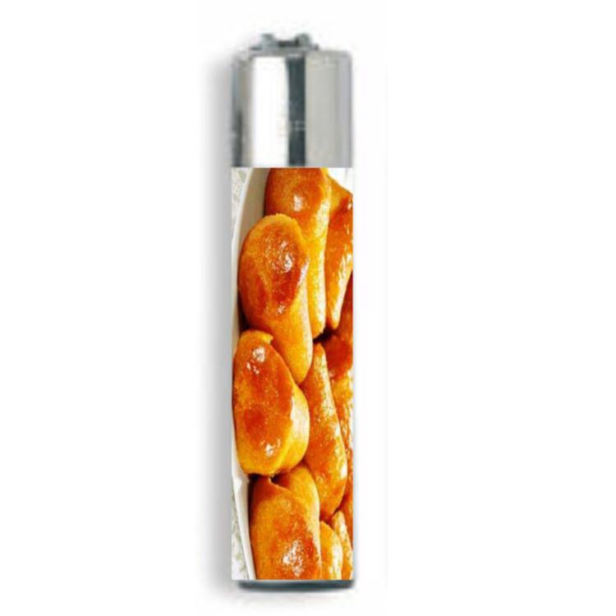
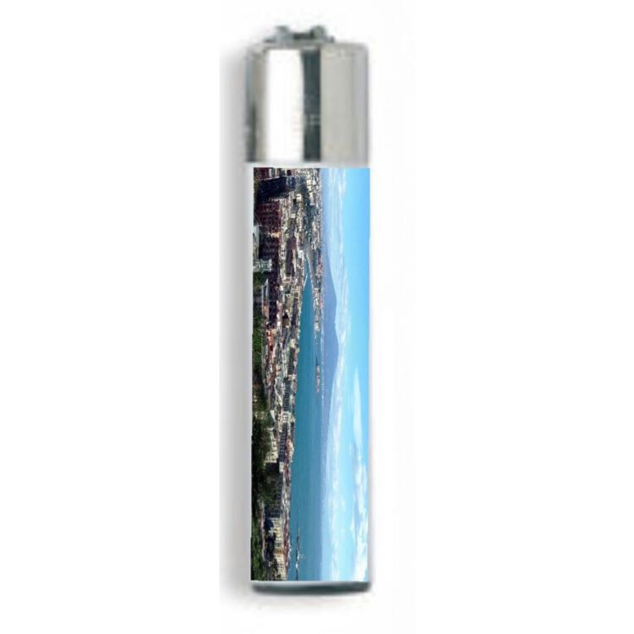
BABA’
One of our neapoletan desserts, we hope you’ll like it.
NAPLES
One of the best landscapes of Naples.

