Slide 1
Naples Only! Catalogue
“To always remember”

Slide 2
Decorated tiles

Slide 3
Vesuvio tiles:
Tiles manually decorated with the image of a simply drawn view of Naples.
Size: 10x10 cm
Price: €5,00 per unit

Slide 4
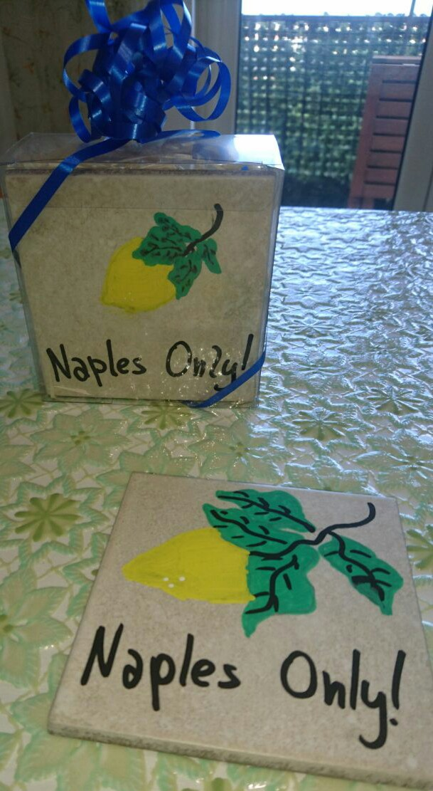
Lemon tiles:
Tiles manually decorated with a simply drawn lemon, a typical symbol of Naples.
Size: 10x10 cm
Price: €5,00 per unit

Slide 5
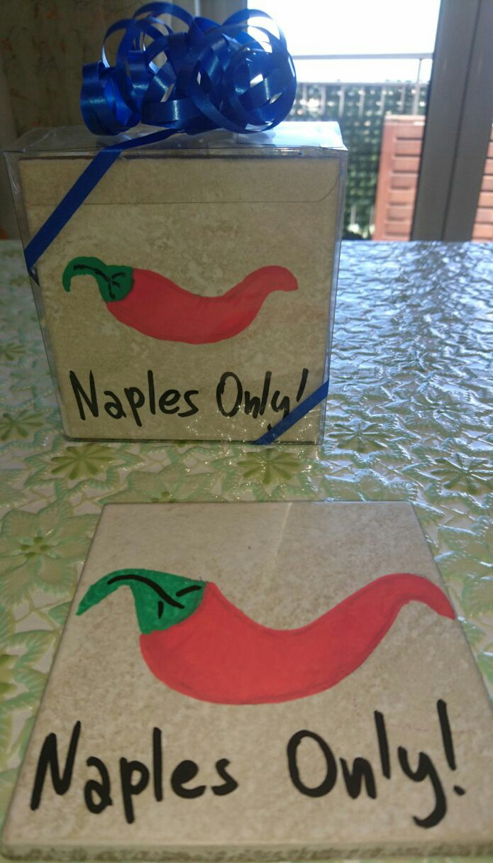
Lucky chili pepper tiles:
Tiles manually decorated with a simply drawn chili pepper, a typical symbol of Naples, that is usually used as a lucky charm locally.
Size: 10x10 cm
Price: €5,00 per unit

Slide 6
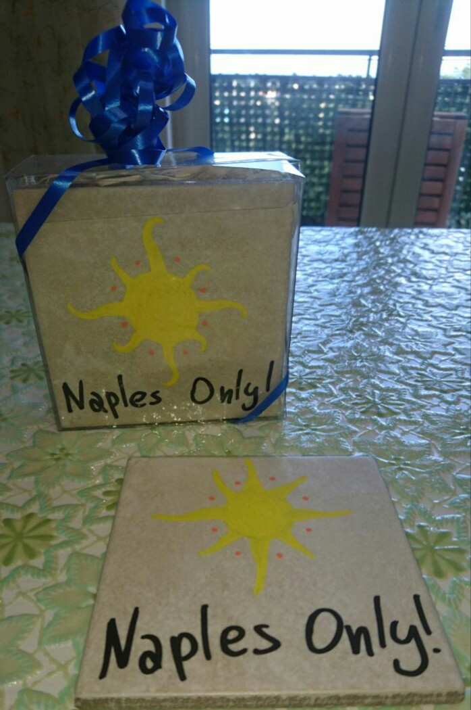
Sun tiles:
Tiles manually decorated with a simply drawn Sun, a bright and warm colored image usually associated with Naples.
Size: 10x10 cm
Price: €5,00 per unit

Slide 7
Gift baskets

Slide 8
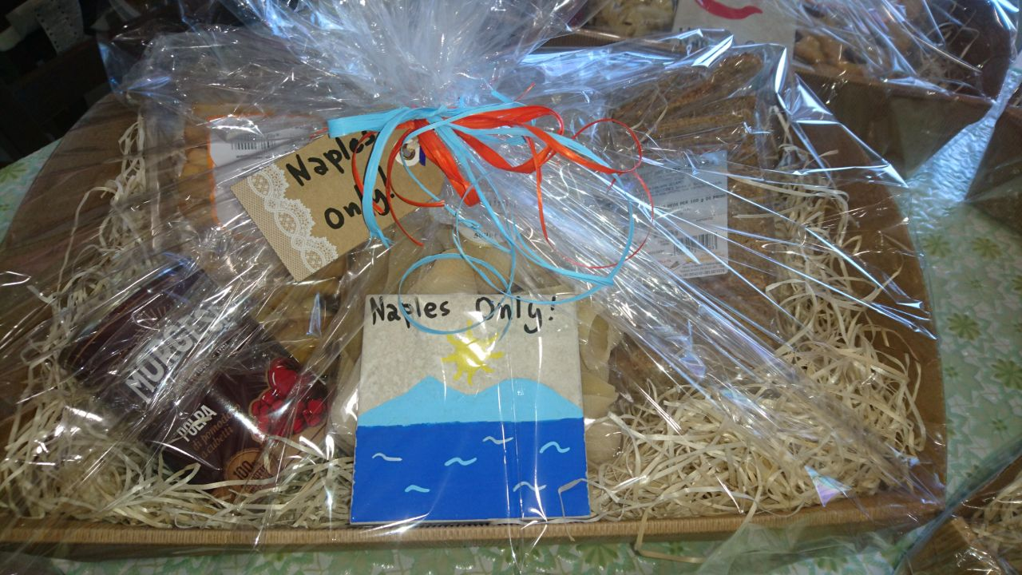
Vesuvio basket:
A gift basket that contains:
One package of Gragnano’s Conchiglioni, which are a type of pasta made in Naples;
One package of Camaldoli’s Bruschette;
One package of Casaburo’s Treccine;
One can of Morgese’s Tomato Pulp;
One Vesuvio tile.
Size: 40x30x37 cm
Price: €14,00 per unit

Slide 9
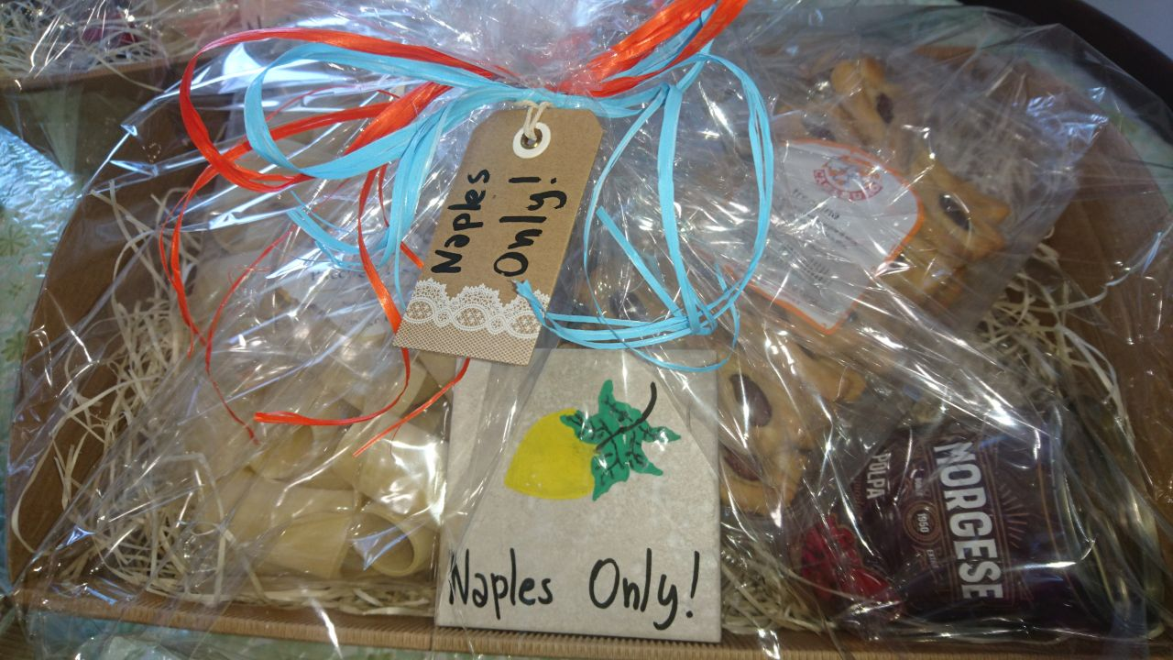
Lemon basket:
A gift basket that contains:
One package of Gragnano’s Paccheri Lisci, which are a type of pasta made in Naples;
One package of Camaldoli’s Bruschette;
One package of Casaburo’s Treccine;
One can of Morgese’s Tomato Pulp;
One Lemon tile.
Size: 40x30x37 cm
Price: €14,00 per unit

Slide 10
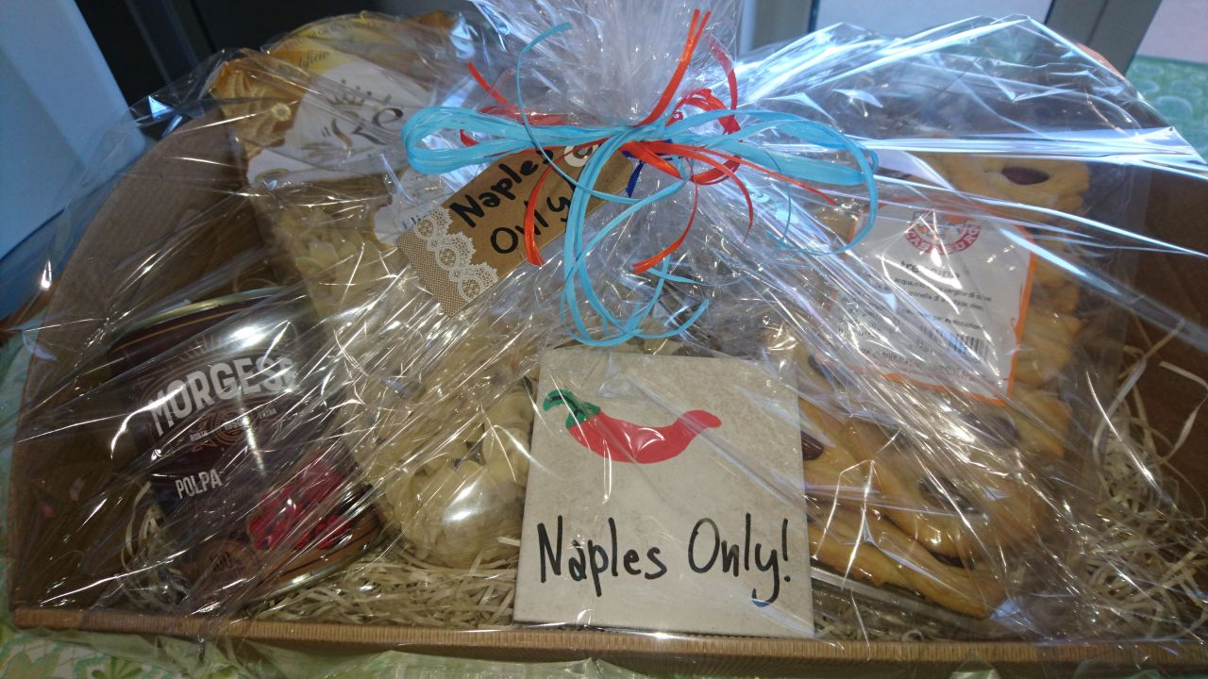
Lucky chili pepper basket:
A gift basket that contains:
One package of Gragnano’s Eliche Giganti, which are a type of pasta made in Naples;
One package of Camaldoli’s Bruschette;
One package of Casaburo’s Treccine;
One can of Morgese’s Tomato Pulp;
One Lucky chili pepper tile.
Size: 40x30x37 cm
Price: €14,00 per unit

Slide 11
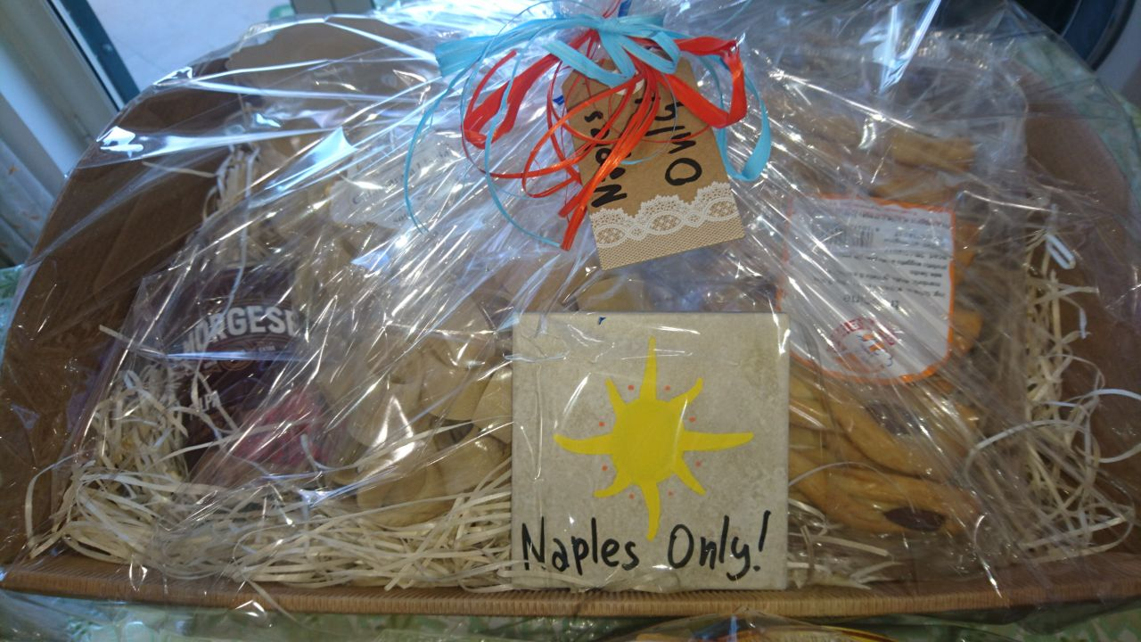
Sun basket:
A gift basket that contains:
One package of Gragnano’s Calamarata Liscia, which is a type of pasta made in Naples;
One package of Camaldoli’s Bruschette;
One package of Casaburo’s Treccine;
One can of Morgese’s Tomato Pulp;
One Sun tile.
Size: 40x30x37 cm
Price: €14,00 per unit

Slide 12
Notes:
All prices include IVA;
All delivery costs are not included in the prices and will be paid by the clients themselves.
For more info about the products or to make an order,
write us via email at fbuffetta@gmail.com
Naples Only!

